Slide 1

Faculty Verification Approval System
TEAM MEMBERS :
M .SATHWIK - 2403A51048
T . SAVIN KUMAR - 2403A51045

Slide 2
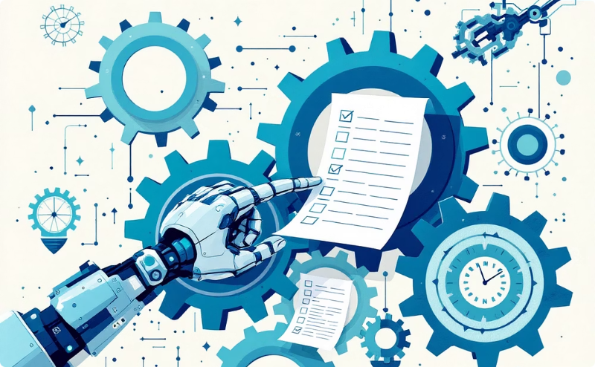



Project Objectives
This project aims to streamline the faculty approval and contract management process within SR University, ensuring efficiency and transparency.
Automated Workflow
Enhanced Transparency
Data Management
Secure Access
Digitize and automate the entire faculty application and approval process, reducing manual paperwork and delays.
Centralize faculty data for easy access, reporting, and efficient management of profiles and contracts.
Implement robust role-based access controls to ensure data security and integrity.
Ensure clear visibility into application statuses and approval stages for all stakeholders.

Slide 3





Key Stakeholders
The system is designed to serve various university personnel, each with distinct roles and access levels.
Faculty Members
Heads of Department (HOD)
Principal
Submit applications, track status, and view contract details.
Provide final approval for faculty appointments.
Review and approve applications relevant to their department.
Management
Students
Oversee the entire approval process and access aggregated data.
Potentially view approved faculty profiles (read-only access).

Slide 4
Technologies Utilised
The project leverages modern web technologies to deliver a responsive and efficient user experience.
HTML5
CSS3
JavaScript
Local Storage
Structuring the web content and defining the layout of the application.
Styling the application for a clean, intuitive, and visually appealing user interface.
Implementing interactive functionalities, form validations, and dynamic content rendering.
For local data persistence and demo control, simulating backend interactions without a server.

Slide 5
TOLLS :
Local Storage
Chatgpt
Text Editor
SOFTWARE :
VS Code
Browser
No other installation of Software.

Slide 6
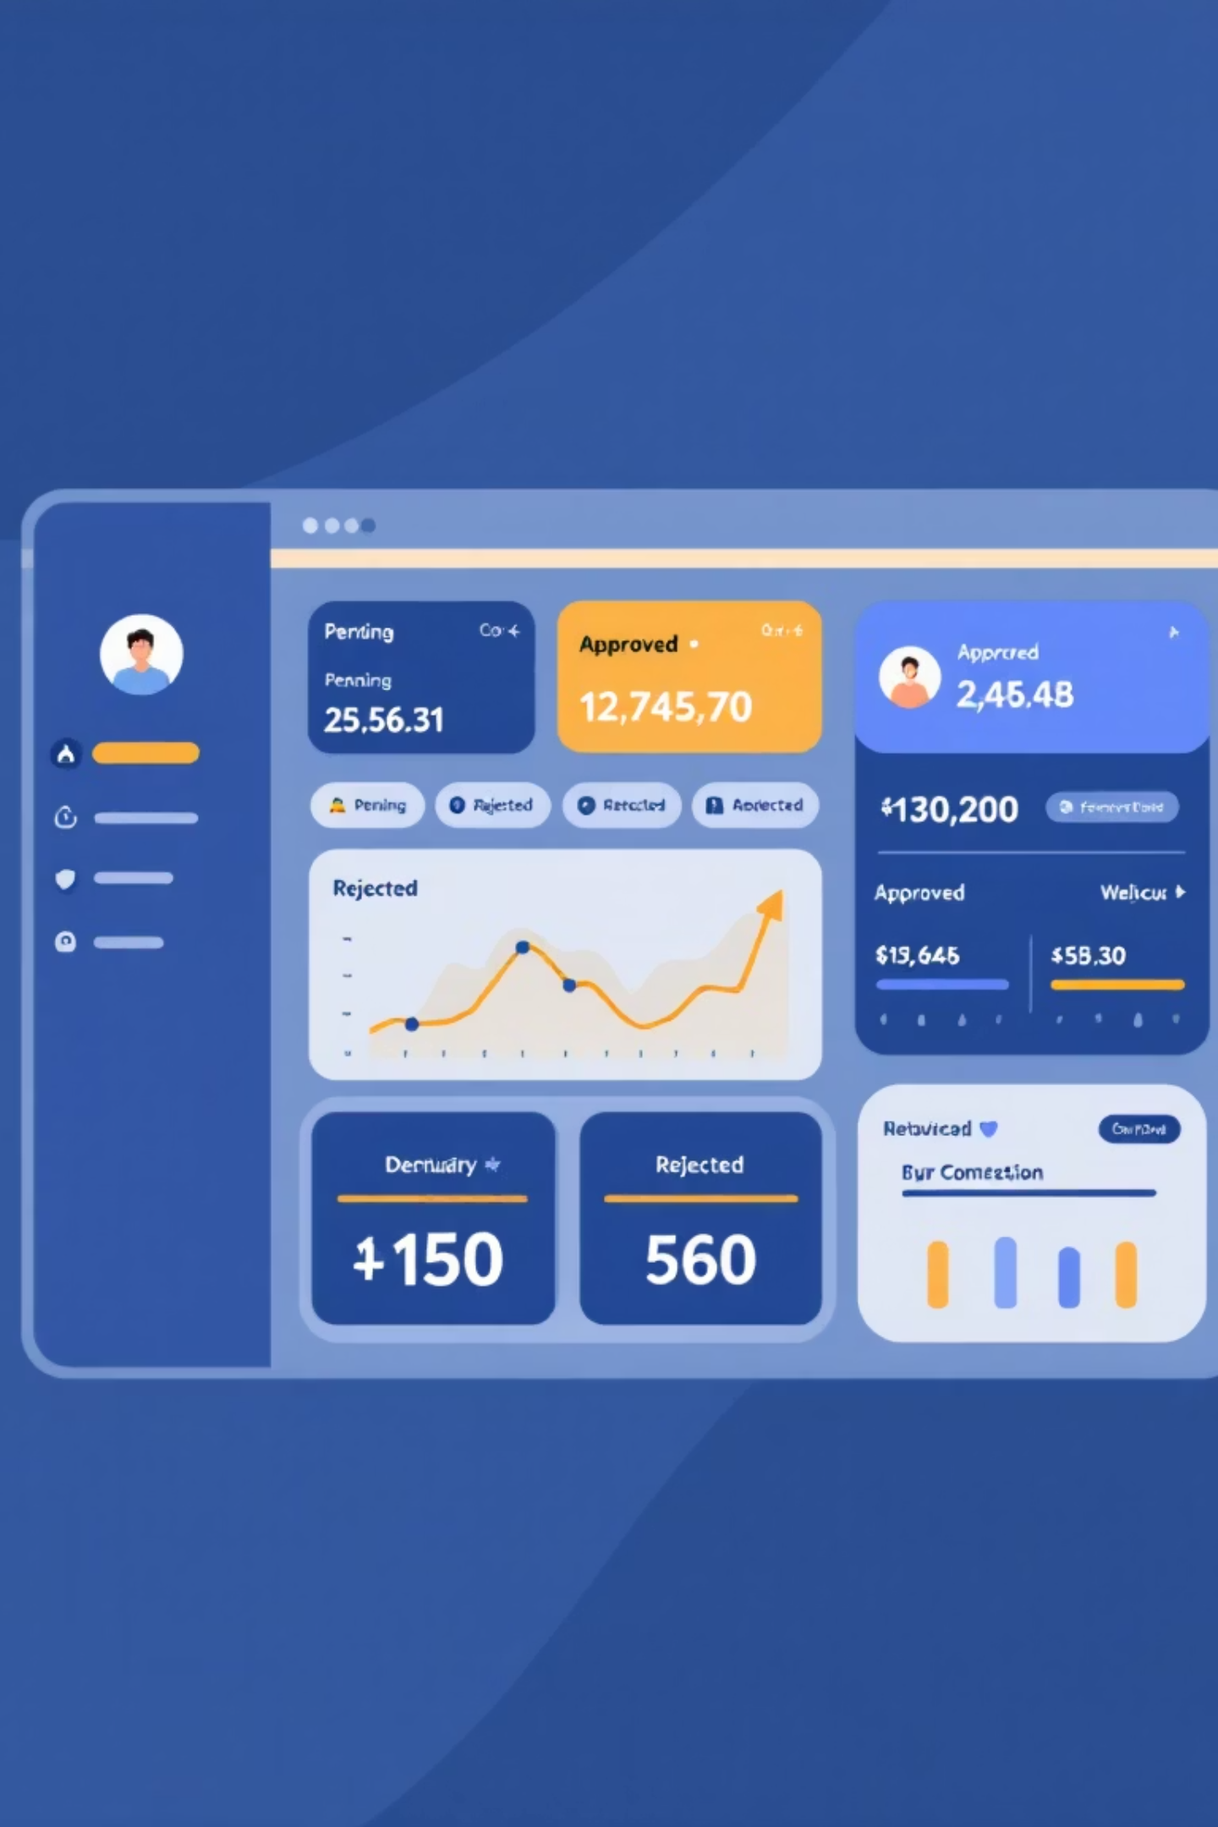
Front-end: Dashboard Overview
The dashboard provides a quick summary of application statuses and enables efficient navigation.
Users can quickly see pending, approved, and rejected applications, along with quick actions to submit new applications or view all submissions.

Slide 7
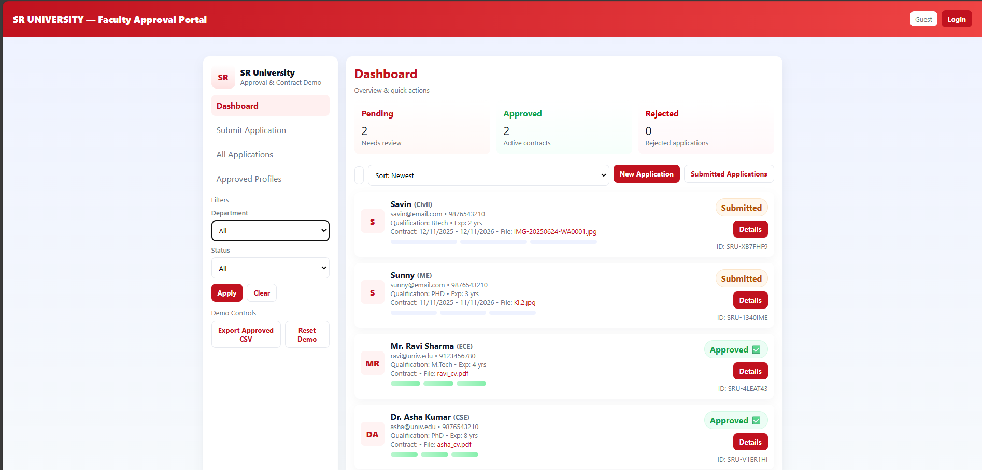

Slide 8
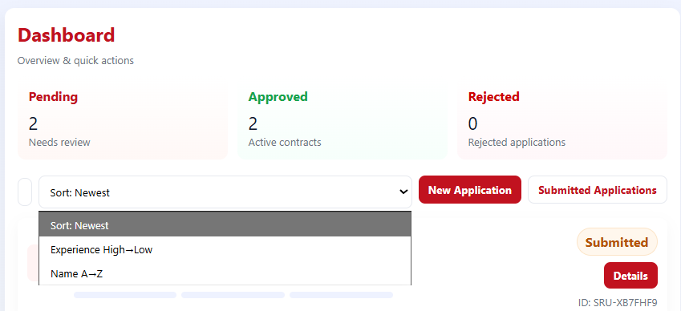
Dashboard: Quick Actions and Filters
The dashboard features intuitive search and filter options, allowing users to efficiently manage and locate specific applications.
Search Bar: Find applications by name, email, or department.
Sort Options: Organise applications by newest, experience, or
name.
Action Buttons: Directly navigate to 'New Application' or 'Submitted Applications' views.

Slide 9
Submitting a Faculty Application
The 'Submit Application' form ensures all necessary information is captured with validation.
The form includes fields for personal details, academic qualifications, experience, and identification documents, with resume upload functionality.

Slide 10
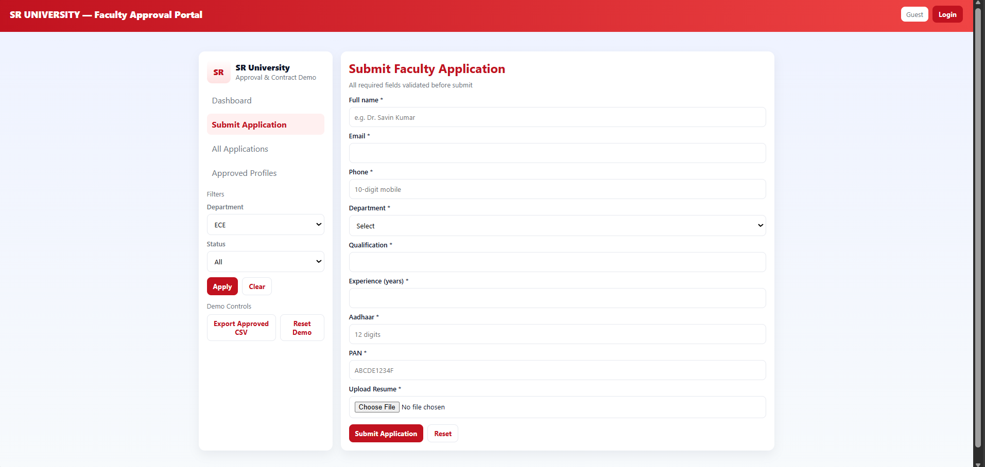

Slide 11
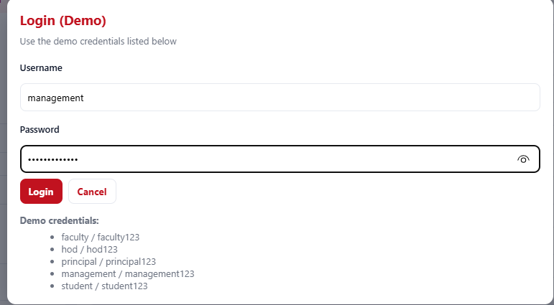
Login Portal & Demo Credentials
Access to the system is secured via a login portal, with specific demo credentials for different user roles.
Demo Login Details:
For demonstration purposes, various user roles have predefined credentials:
Faculty: faculty / faculty123
HOD: hod / hod123
Principal: principal / principal123
Management: management / management123
Student: student / student123
These roles enable a comprehensive demonstration of the
workflow approvals.

Slide 12




Approval Workflow: A Seamless Journey
Applications progress through a clear, multi-stage approval process, ensuring thorough review.
Application Submitted
Approved by HOD
Faculty member completes and submits the online application form.
Head of Department reviews and approves the application.
Approved by Principal
Approved & Contract
Principal gives the final approval, moving the application to the next stage.
Application is fully approved, and contract generation proceeds.

Slide 13
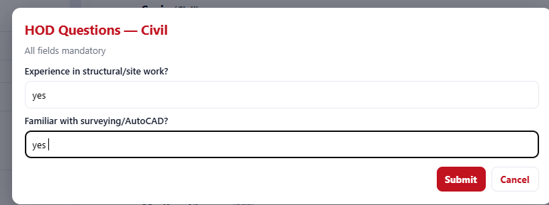

Slide 14
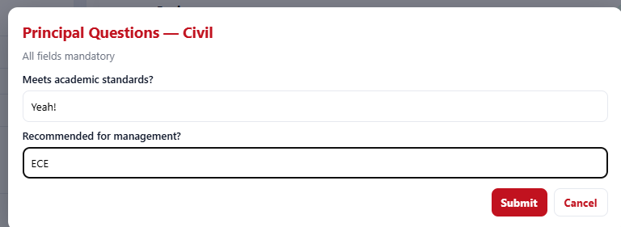
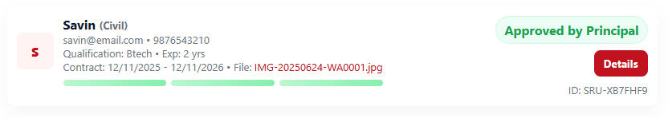
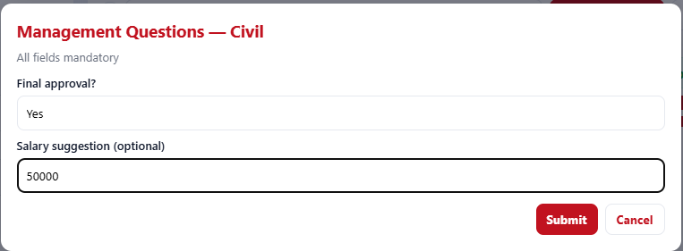

Slide 15
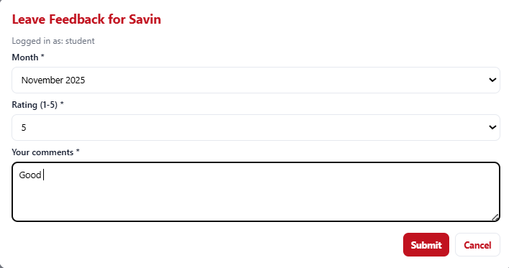
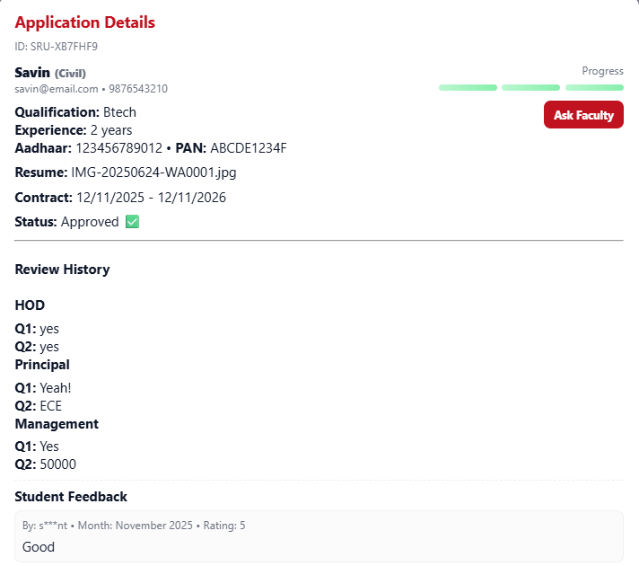

Slide 16
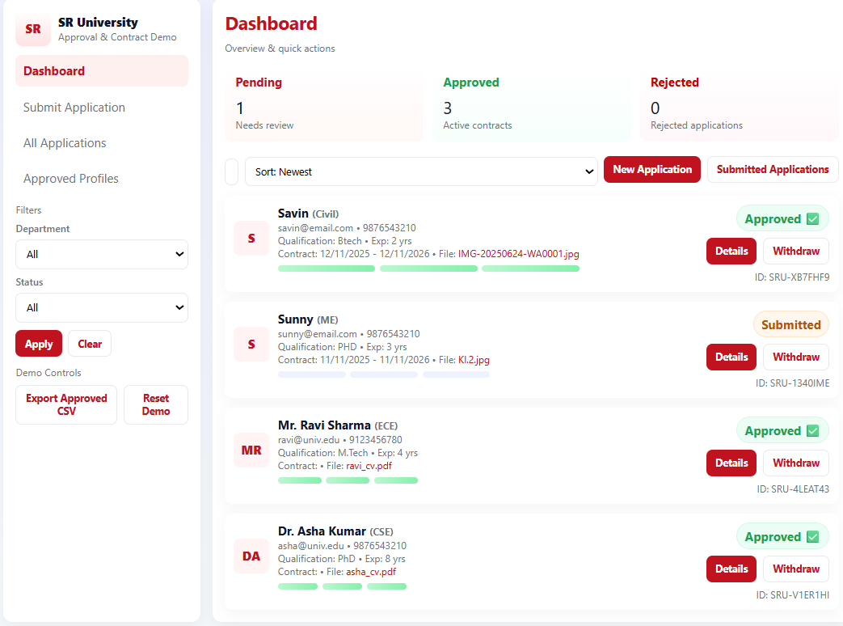

Slide 17

Thank You.

